Slide 1
Work Flow
Vlatko Pistolov
06.07.2012

Slide 2
Contents – Part 1
  Project implementaion
    Idea
    SRS document
    Team
    Time plan
    Implementation
    Delivery
Vlatko Pistolov
Page <number>
06.07.2012

Slide 3
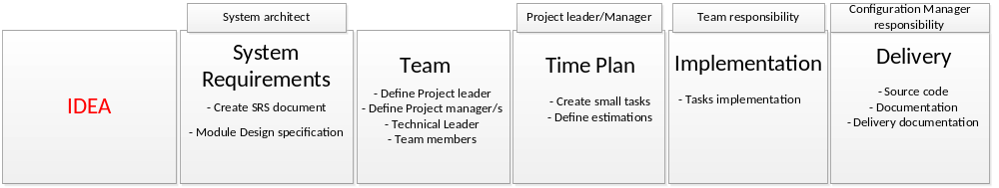
IDEA
Presentation of the idea
Market research
Business Analyze
Vlatko Pistolov
06.07.2012

Slide 4
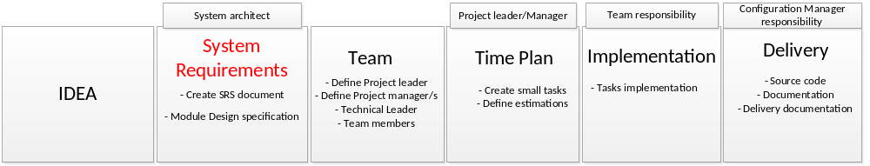
System Requirement
Create SRS (System Requirement Specification )
Create Module Design Specification
Vlatko Pistolov
06.07.2012

Slide 5
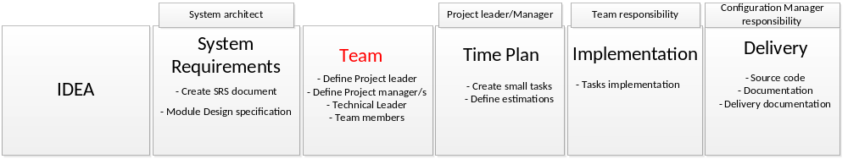
Team
Define Project leader
Define Project Manager
Define Technical Leader/Team Leader
Define Team members

Slide 6
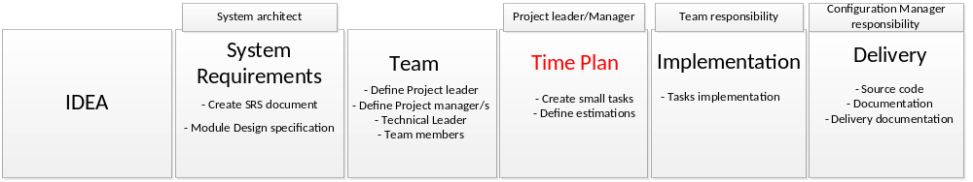
Time Plan
Create small tasks
Define Estimations for the tasks

Slide 7
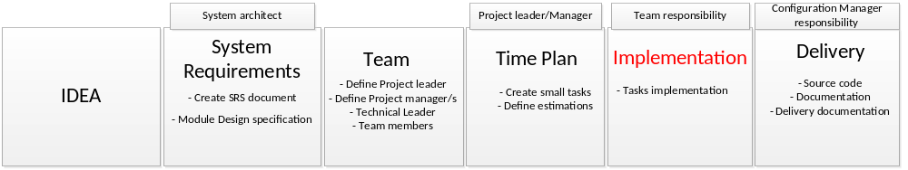
Implementation
Tasks Implementation

Slide 8
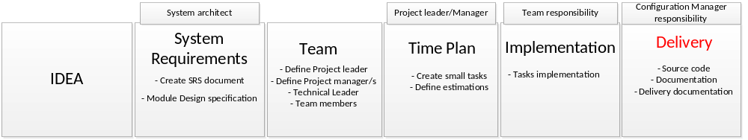
Delivery
Source code
Documentation
Delivery documentation

Slide 9
Contents – Part 2
  Task Implementaiton
    Task (source information)
    Analyze phase
    Implementation phase
    Internal tests
    QA verification
    Delivery
Vlatko Pistolov
06.07.2012

Slide 10
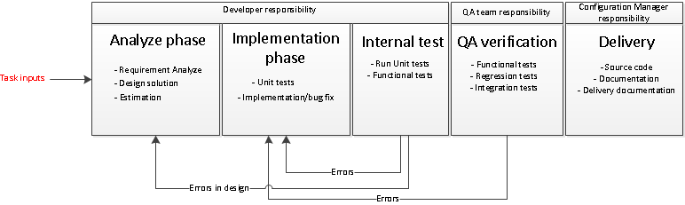
Task – Source information
Requirement specification (SRS document)
Requirements
Vlatko Pistolov
Page <number>
06.07.2012

Slide 11
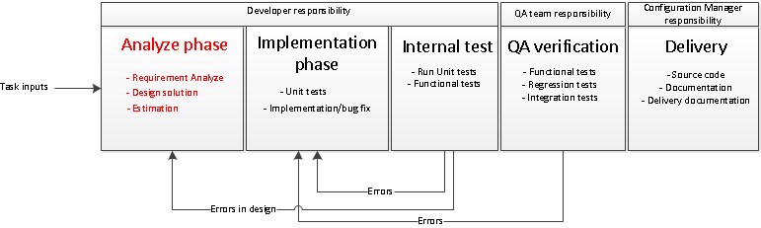
Analyze phase
Requirement analyze
Design solution
Estimation
Vlatko Pistolov
Page <number>
06.07.2012

Slide 12
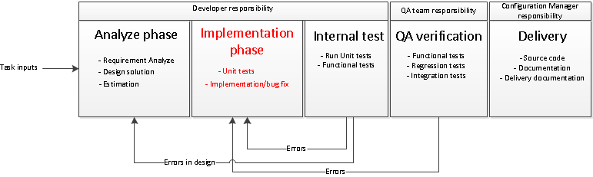
Implementation phase
Unit tests (if is used TDD methodology)
Functions implementation or bug fix
Vlatko Pistolov
Page <number>
06.07.2012

Slide 13
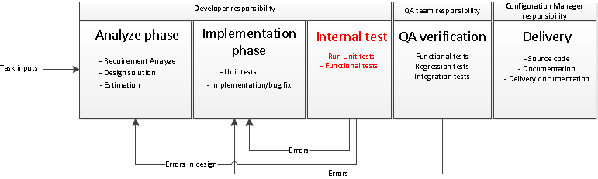
Internal tests
Functional tests
Unit tests (if exist)
Vlatko Pistolov
Page <number>
06.07.2012

Slide 14
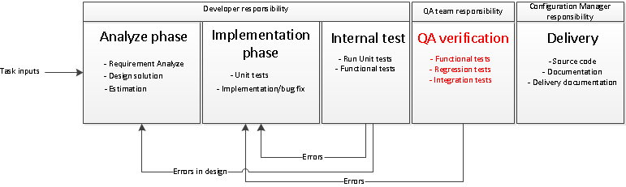
QA verification
Functional tests
Regression tests
Integration tests
Vlatko Pistolov
Page <number>
06.07.2012

Slide 15
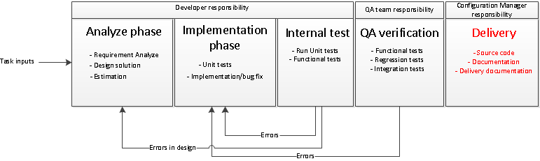
Delivery
Source code delivery
Documentation
Delivery documentation
Vlatko Pistolov
Page <number>
06.07.2012

